Slide 1
FONTAN CIRCULATION
Dr Madhusudan Raikar
Senior Resident,
Dept. of Cardiology,
Medical College, Calicut

Slide 2
CONTENT OF DISCUSSION
Introduction
The ‘Fontan’ concept
Indications for Fontan Operation
Evolution of Fontan Operation
Fontan physiology
Sequelae of Fontan Operation
Treatment of Circulatory Failure
Complications of Fontan Operation
Post-op follow up
Long term results

Slide 3
INTRODUCTION
Normal post natal cardiovascular system consists
double circuit connected in series
—systemic
—pulmonary
powered by a double pump
—the right and left heart

Slide 4
Many complex cardiac malformations - one functional ventricle (univentricular heart)
Maintains systemic and pulmonary circulation - not connected in series but in parallel
Major disadvantages
arterial desaturation
chronic volume overload to single ventricle(SV) – in due course impairs ventricular function

Slide 5
Effects of chronic volume overload on SV :
Dilatation of atrium and ventricle
Eccentric hypertrophy
Spherical remodelling with reorientation of wall fibers
Annular dilatation causing progressive AV valve regurgitation

Slide 6
Hemodynamic problems in univentricular heart arise from :
Lack of interventricular coupling
Volume overload on SV
Mechanics of morphologic RV vs. LV
Morphology and functional state of AV valves
Degree of mixing within SV
Pulmonary vascular resistance (PVR)
Presence of pulmonic or subaortic stenosis

Slide 7
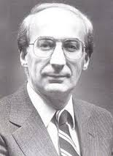
THE ‘FONTAN’ CONCEPT
1971, Francis Fontan and Baudet – new approach

Slide 8
Fontan Circulation
The systemic venous return enters the pulmonary circulation, without an interposing ventricle, and
All shunts at the venous, atrial, ventricular and arterial level are interrupted
Thus places the systemic and pulmonary circulations in series driven by a SV
post capillary energy - no longer wasted in systemic veins, but collected and used to push blood through lungs

Slide 9
Advantages of a Fontan circuit :
(near) normalisation of the arterial saturation
abolishment of chronic volume overload on SV
Cost for such circulation :
Chronic systemic venous hypertension and congestion
decreased cardiac output, both at rest and during exercise
Cardiac output - no longer determined by heart, but by the transpulmonary flow (in turn regulated by PVR)

Slide 10
Paradox of Fontan Circulation
Normally, good hemodynamic state has low pressure in IVC(< 10 mmHg) and mPAP atleast 15 mmHg.
In fontan, systemic venous hypertension and pulmonary arterial hypotension
This pressure gradient → driving force for PBF, assissted mechanically by thoracic muscles and respiratory function.

Slide 11
INDICATIONS FOR FONTAN CIRCUIT :
Cardiac malformation and a single functional ventricle resulting from
dysfunctional heart valve
absent or inadequate pumping chamber
Most common CHDs palliated with fontan circulation :
Tricuspid atresia
Pulmonary atresia with intact ventricular septum
Hypoplastic left heart syndrome
Double-inlet ventricle
d-TGA is never palliated with fontan circulation

Slide 12
Ideal Patient For Fontan : 1978, Choussat et al
Original criteria proposed for Fontan completion (TEN commandments)
age > 4 and < 15 years
normal sinus rhythm
normal systemic venous connections
normal right atrial volume
Mean PA pressure ≤ 15 mmHg
pulmonary vascular resistance < 4 Woods units/m²
adequate-sized PA (PA to aortic diameter ratio ≥ 0.75)
left ventricular ejection fraction ≥ 60%
Competent mitral valve (absence of mitral valve insufficiency)
absence of PA distortion

Slide 13
With increasing experience, criteria have become more flexible
2 most important commandments in present era:
Pre-op impaired ventricular function and
Elevated PA pressures

Slide 14
Cardiac Catheterization For Pre-fontan Evaluation :
Patency of glenn shunt with analysis of PA anatomy :
Good sized PA without distortion
Confluence stenosis (stenosis > 50% as compared to adjacent segment)
Presence or absence of anomalously draining pulmonary veins in levophase
Any significant decompressing venovenous collaterals (>2 mm)

Slide 15
IVC angiogram :
Rule out interrupted IVC
Rule out stenosis / duplication of IVC
Drainage pattern of hepatic veins
Ventriculogram :
Ventricular contractility
AV valve regurgitation
Systemic outflow obstruction
Presence or absence of antegrade flow from ventricle to PA

Slide 16
Hemodynamic evaluation :
PA pressures (systolic / diastolic / mean)
PVR
Ventricular end diastolic pressures
2 most important cath data (both mandatory)
PA pressure
PVR

Slide 17
Is cardiac catheterization mandatory?
NO
Alternative – cardiac MRI
Consensus opinion – pre-op cath study must
Only valid method to measure PVR
Abnormal aortopulmonary / venovenous collaterals identified (can be embolized at same instance)

Slide 18
EVOLUTION OF FONTAN OPERATION :
Since its original description, the Fontan circuit has seen numerous modifications.
Helped advance the procedure and improved patient outcomes.
In early 1980s, NORWOOD -“novel Concept”
using the RV in HLHS to serve the systemic circulation.
This discovery created a large new population of candidates for Fontan palliation.

Slide 19
Atrio-Ventricular Connection :
In early yrs, a power source other than the main ventricle was believed to be necessary.
Closed the ASD and interposed a valved homograft b/w the RA and the small RV.
Bjork and colleagues (modified approach)
valveless RA to RV connection using a pericardial onlay patch.
Completely abandoned
poor results
high incidence of reoperations.

Slide 20
Atrio-Pulmonary Connections
Concept : hypertrophied RA in tricuspid atresia could act as a pump.
Initially, inlet and outlet valves were incorporated using aortic / pulmonary homograft valve. (became evident - not necessary)
Kreutzer and colleagues, used pulmonary valve b/w RA to PA.

Slide 21
Original Fontan Procedure
SVC to RPA anastomosis (Glenn shunt)
Anastomosis of RA appendage to LPA directing IVC flow through a valved homograft
Placement of a valved homograft at the IVS-RA junction
Closure of the atrial septal defect

Slide 22
Problems :
RA dilated and lost contractile function
Turbulence and energy loss
Decreased pulmonary blood flow
Stasis and thrombosis
Right atrial–pulmonary circuits - obsolete

Slide 23
Total Cavo-Pulmonary Connection
In 1987, de Leval et al (lateral tunnel)
direct connection between each vena cava and PA
Bypass the right atrium and right ventricle
In 1990, Marcellati (extra cardiac fontan)
extra cardiac interposition graft b/w IVC and PA.
Advantages :
More efficient cavopulmonary blood flow
reduce risk for arrhythmia and thrombosis

Slide 24
Modern Fontan procedure involves connecting SVC and IVC to the RPA
Originally performed at the same time
Resulted in a marked increase in blood flow to the lungs
pulmonary lymphatic congestion and pleural effusions
No longer performed together

Slide 25
Currently total cavopulmonary Fontan circulation done in two stages :
To allow body to adapt to different hemodynamic states
Reduce overall surgical morbidity and mortality
Allows a better patient selection and intermediate preparatory interventions

Slide 26
As no ventricle to pump blood through the lungs, elevated PAH - absolute contraindication
At birth, impossible to create a Fontan circulation
PVR is still raised for several weeks
Caval veins and pulmonary arteries - too small

Slide 27
Present Day Fontan
Initially in the neonatal period, management must aim to achieve :
Unrestricted flow from the heart to the aorta
coarctectomy
Damus- Kaye-Stansel
Norwood repair
Well balanced limited flow to the lungs
pulmonary artery band
modified Blalock-Taussig
Unrestricted return of blood to the ventricle
Rashkind balloon septostomy

Slide 28
Bidirectional Glenn Shunt / Hemi-fontan
At 4–12 months of age
First half of creating a total cavopulmonary circulation circuit
End-to-side anastomosis between SVC & RPA
RPA is not divided, resulting in blood flow from the SVC into the right and left PA
Children may remain cyanotic because blood from the IVC is not directed to the lungs

Slide 29
Bidirectional Glenn Shunt / Hemi-fontan
Cardiac end of divided SVC - attached to MPA or under surface of RPA
Lower stump of SVC - connected to IVC with a conduit
Open end of SVC - oversewn or occluded with a PTFE patch
Allows Fontan circulation to be completed later

Slide 30
Completion of Fontan
When patients reach 1–5 years of age total cavopulmonary Fontan circuit is completed
IVC connected to pulmonary artery with a conduit
SVC flow is already directed into the RPA by a previous bidirectional Glenn shunt

Slide 31
Total cavo-Pulmonary connection can be done in 2 methods :
Internal conduit - pass through the right atrial chamber
External conduit - run completely outside the heart to the right side of the right atrium

Slide 32
Intra-atrial Tunnel Method
Conduit is constructed with both the lateral wall of the RA and prosthetic material
Inferior aspect of the tunnel is anastomosed to the IVC
superior aspect is anastomosed to the pulmonary arteries

Slide 33
Advantages :
Conduit enlarges as the child grows - may be used in children as young as 1 year old
Decreased blood stasis and risk of thrombosis
Limited portion of RA exposed to high venous pressures (reduces risk of arrhythmias)
Coronary sinus remains in low pressure atrium (allows unimpended myocardial venous drainage)

Slide 34
Extracardiac Conduit Method
Usually performed only in pts. > 3 years
PTFE tube graft is placed between the transected IVC and the PA , bypassing RA.

Slide 35
Advantages :
No or minimal CPB
Entire atrium is left with low pressure - less atrial distention, arrhythmia, and thrombosis.
Avoids RA incisions and extensive atrial sutures
Reduces risk of sinus node injury
Reduces incidence of post op arrhythmias
Disadvantages :
Cannot enlarge as the child grows
Performed only in child large enough to accept a graft of adequate size to allow adult IVC blood flow.
Risk of obstruction by thrombus formation or neo intimal hyperplasia

Slide 36
Fenestrated Fontan
small opening or fenestration may be created between the conduit and the right atrium
Functions as a pop-off valve (a right-to-left shunt)
prevent rapid volume overload to the lungs
Limit caval pressure
Increase preload to the systemic ventricle
Increase cardiac output
cyanosis may result from the right-to-left shunt

Slide 37
Fenestrations decrease postop pleural effusions
May be closed after patients adapt to new hemodynamics
Now, fenestrations are seldom created during the completion of the Fontan
improved patient selection and preparation
improved staging

Slide 38
FONTAN PHYSIOLOGY
Man-made neoportal system, where one capillary bed pools blood into another capillary bed without receiving energy from a pump.
critical bottleneck within this circulation.
Output through a bottleneck is determined by
pressure just above (systemic veins) and below (pulmonary veins) the bottleneck
resistance within the bottleneck (PVR)

Slide 39
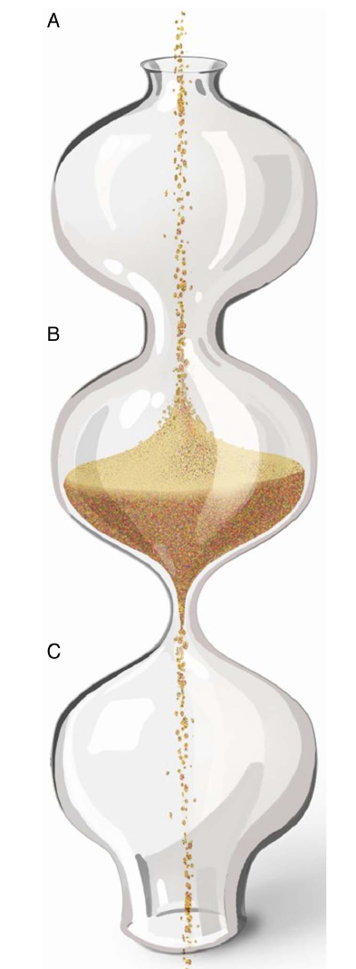
Bottle neck concept

Slide 40
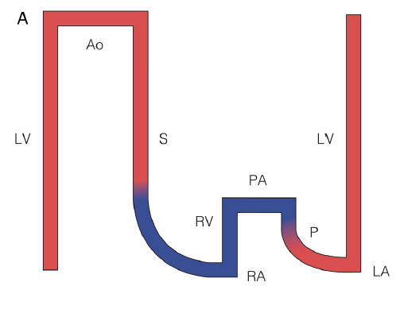
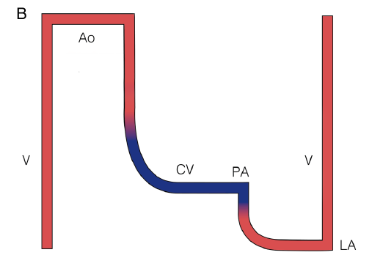
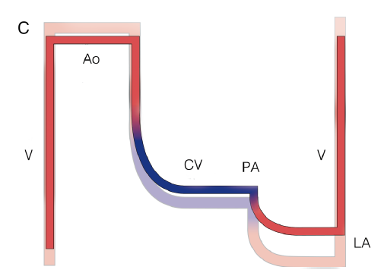
Normal biventricular circulation
Early fontan circulation
Late fontan circulation

Slide 41
Role of ventricle in fontan circuit
no longer controls the cardiac output
nor decreases the extent of congestion in the systemic veins
Only pumps the output allowed by Fontan circuit
Deteriorates over time by increasing its end-diastolic pressures
Further worsens systemic venous congestion and reduces output

Slide 42
Throughout the Fontan strategy, the ventricle is exposed to different and extreme loading conditions.
During fetal life and the initial palliation, the SV is volume overloaded (250%–350% for BSA)
At the time of Glenn shunt, the volume load on the SV is reduced to about 90% for BSA.
At completion of Fontan circuit reduces down to 50%–80% for BSA
Volume overloaded and overstretched → overgrown and severely deprived.

Slide 43
Chronically decreased preload leads to arterial vasoconstriction and increased afterload for the ventricle
Hence shows both systolic and diastolic dysfunction
vicious cycle : low preload → remodelling → reduced compliance and increasing filling pressures → decreases preload
The ventricle - not the critical bottleneck, but the diastolic suction required for forward flow.
diastolic dysfunction evolves from a minor to a major contributor of the failing circulation

Slide 44
Use of ACE inhibition in Fontan patients
Enalapril or placebo was given for 10 weeks in 18 pts. approx. 14 yrs after Fontan operation
Tendency to worsen exercise performance
Reduced incremental cardiac index during exercise in the patients receiving enalapril
Kouatli et al ,Enalapril does not enhance exercise capacity in patients after Fontan procedure. Circulation Sep 2 1997;96(5):1507–12.

Slide 45
Many patients continue to receive ACE inhibition, in the hope of a beneficial effect when given chronically
It is possible that there are subgroups that may benefit e.g. severe systolic dysfunction
Presently no evidence for this therapy being beneficial

Slide 46
Relationship b/w CO,PVR and contractility
Increase in contractility (systolic function) will not lead to increases in cardiac output at rest.
No role for inotropes as preload is limited

Slide 47
Fontan Fenestration
In any bottleneck, upstream congestion and downstream limited flow can be mitigated if adequately bypassed.
Advantages :
improvements in cardiac output
decrease in venous congestion
Disadvantages :
arterial desaturation.

Slide 48
Green line - Good fontan
Red line – Bad fontan

Slide 49
Exercise and Fontan circulation
Normal individuals increase their PBF significantly during peak exercise.
Reduction in PVR
vasodilation and
recruitment of segments
Increased RV work
flow acceleration
increased systolic pressures up to 70 mm Hg.

Slide 51
Pulmonary artery flow in Fontan is relatively low velocity and laminar
Different to the normal pulsatile flow of pulmonary vascular bed in normal circulation
Release of nitric oxide from the endothelium is dependent on pulsatile flow in the normal circulation
Experimentally, reducing pulsatility leads to reduced NO production and an increase in vascular resistance
Nakano T et al, Pulsatile flow enhances endothelium-derived nitric oxide release in the peripheral vasculature. Am J Physiol Heart Circ Physiol Apr 2000;278(4):

Slide 52
Pulmonary vasculature in fontan
Black line – Normal
Green line – Good pul vascular growth
Yellow line – Poor pul vascular growth

Slide 53
Growth and development of pulmonary arteries during infancy prior to the Glenn shunt is crucial.
Initial palliative procedure (banding or shunt) - most important intervention and determinant of good Fontan haemodynamics.
Current strategy :
very limited period of controlled pulmonary ‘overflow’ and catch-up growth.
using small shunts to avoid a volume-overloaded ventricle

Slide 54
Evolution of PVR with age

Slide 55
SEQUELAE OF FONTAN OPERATION
Perioperative mortality : 3-5 % (< 2 % in recent data)
Overall survival
5 yrs – 86%
10 yrs – 81%
15 yrs – 73%
10 yr survival (lateral tunnel) – 87%
10 yr survival (extracardiac) – 92.4%

Slide 56
Independent predictors of mortality:
Pre-op high PA pressure
Severe infection in early post-op period
Early morbidities :
Pleural and pericardial effusion
Low cardiac output
Sinus node injury
Pulmonary and systemic venous obstruction

Slide 57
Factors asso. with long term morbidity:
Progressive ventricular dysfunction
Systemic venous hypertension
RA distension (classical)
Thromboembolic episodes
Worsening cyanosis
Heterotaxy syndromes
Significant AV valve regurgitation
NYHA class III / IV (pre-op)
Elevated PA pressure (pre-op)

Slide 58
TREATMENT OF CIRCULATORY FAILURE :
Treatment strategies:
open up the bottleneck (decrease impedance of neoportal system)
bypass the bottleneck (fenestration)
increase the pressure before the bottleneck (systemic venous pressure)
enhance run-off after the bottleneck (ventricular suction).

Slide 59
Increase in Systemic Venous Pressures
Temporarily increase cardiac output during exercise (up to 30 mm Hg)
Chronic high venous pressures in excess of 18–20 mm Hg - poorly tolerated
Results in
Congestion (oedema, ascites, lymphatic failure)
progressive veno-venous collaterals with cyanosis.
Use of Diuretics – worsens preload .

Slide 60
Decrease in impedance in neoportal system
conversion to cavo-pulmonary connection (in older circuits).
Early detection and Mx of focal areas of stenosis, hypoplasia, distortion or excessive collateral flow.
Regular exercise and adapted breathing patterns (lowers PVR by vessel recruitment and vasodilation).

Slide 61
Work of breathing is a significant additional energy source to circulation in Fontan
Normal negative pressure inspiration has been shown to increase PBF after the atrial pulmonary connection and TCPC
Redington AN, Penny D, Shinebourne EA. Pulmonary blood flow after total cavopulmonary shunt. Br Heart J Apr 1991;65(4):213–7

Slide 62
Philadelphia group (using magnetic resonance flow measurements)
estimated that approximately 30% of the cardiac output can be directly attributed to work of breathing in patients after the TCPC
Fogel MA,Weinberg PM, Rychik J, et al. Caval contribution to flow in the branch pulmonary arteries of Fontan patients Circulation Mar 9 1999;99 (9):1215–21.

Slide 63
Positive pressure ventilation
Increasing levels of PEEP during positive pressure ventilation is adverse to Fontan circulation
Higher the mean airway pressure, lower cardiac index
Maintain with minimum mean airway pressure compatible with normal oxygenation and ventilation
Williams DB, Hemodynamic response to positive end-expiratory pressure following right atrium-pulmonary artery bypass (Fontan procedure). J Thorac Cardiovasc Surg Jun 1984;87(6):856–61y

Slide 64
Modification of PVR :
oxygen at altitude
sildenafil
bosentan
Inhaled iloprost
Modest haemodynamic improvements

Slide 65
Bosentan improves exercise capacity, exercise time and functional class in Fontan patients without serious adverse events or hepatotoxicity.
Anders Hebert et. al. Bosentan Improves Exercise Capacity in Adolescents and Adults After Fontan Operation: The TEMPO Study .circulation 2014

Slide 66
Ventricular suction
No lusiotropic drugs available currently.
Agents which alter contractility, heart rate or afterload – negligible effects.

Slide 67
Fenestration
Proven to improve cardiac output and reduce congestion.
Closing the fenestration - improved oxygen saturations both at rest and during exercise.
Secondary creation of a fenestration late in a failing but ‘pink’ Fontan – not well tolerated.
percutaneous fenestration may have a role while awaiting cardiac transplant.

Slide 68
COMPLICATIONS OF FONTAN OPERATION

Slide 69
Right Atrium (Classic Fontan Operation)
Dilatation – leads to
Arrhythmias
Blood stasis – poor PBF and thrombosis
Atriotomy – injury to sinus node and conducting fibers
Treatment :
Conversion to extra cardiac cavopulmonary circuit
right atrial maze procedure (to reduce arrhythmia),
right atrial reduction plasty,
pacemaker

Slide 70
Inferior Vena Cava
Chronic venous hypertension leads to :
increased hepatic sinusoidal pressure and loss of venous pressure gradient
portal venous hypertension and hepatic dysfunction
Portal hypertension - splenomegaly and portosystemic shunts.
Hepatic encephalopathy
Cardiac cirrhosis
Hepatocellular carcinoma

Slide 71
Left Ventricle
Manifests as exercise intolerance
Causes of LV dysfunction :
Altered mechanics of ventricle in fontan circulation
congenital malformation – predispose to ventricular dysfunction,
Previous surgical interventions
morphologic RV or an indeterminate primitive ventricle,
AV valve regurgitation
High right atrial pressure → disadvantageous coronary blood flow → affects myocardial perfusion and function.
Coronary sinus blood - surgically redirected to drain into the LA

Slide 72
Pulmonary Circulation
paradox of systemic venous hypertension (mean pressure, >10 mm Hg) and pulmonary artery hypotension (mean pressure, <15 mm Hg)
pulmonary arteries - morphologically abnormal (ie, small, discontinuous, or stenosed)
Stenosis or leakage of surgical anastomoses – adverse effect on PBF

Slide 73
Collateral Vessels And Shunts
increased risk for formation of pulmonary arteriovenous malformations (chronic underfilling).
Significant right-to-left shunts and cyanosis
Causes :
Patent collateral vessels between systemic veins and pulmonary veins
Patent systemic veins that extend directly into the left atrium
Incomplete closure of ASD
Redirection of coronary sinus to LA
Fenestration fontan

Slide 74
Left-to-right shunts :
Aortopulmonary collateral vessels
Results in
volume overload of the SV
increased PBF and PA pressure

Slide 75
Coagulation abnormalities
Reason :
Dilated atrium
low cardiac output
coagulation abnormalities associated with hepatic congestion
chronic cyanosis–induced Polycythemia
Additionally,
protein C/S and antithrombin III deficiency(liver dysfunction),
increased platelet reactivity
PLE
(alter balance b/w pro- and anti-coagulants)

Slide 76
Increased frequency of pulmonary thromboembolic events
venous thromboembolism (3%–16% )
Stroke (3%–19%)
Massive pulmonary embolism - most common cause of sudden out-of-hospital death

Slide 77
No consensus on post op mode and duration of prophylactic anticoagulation
Aspirin – uncomplicated pts.
Full anticoagulation
Previous thrombi
Spontaneous ECHO contrast
Arrhythmias
Dilatation of atrial / venous structures
PLE
Protocol in JICSR,Bangalore
Oral anticoagulants – 1 yr post op
Switch over to oral antiplatelets
Restart oral anticoagulation – 10 yr post op

Slide 78
Severe Hypoxemia (Post-fontan)
Pts with fontan – baseline SpO2 94+2%
If severe desaturation (rule out)
Large fenestration
Intrapulmonary AV fistulae
Abnormal venovenous collaterals
If present needs percutaneous occlusion

Slide 79
Functional Status And Exercise Tolerance
Most patients lead a nearly normal life, including mild to moderate sport activities.
More than 90% of all hospital survivors are in NYHA functional class I or 2
Do well educationally and pursue variety of professions.
In time, progressive decline of functional status in some subgroups

Slide 80
Arrhythmia
Incidence 10-40% upto10 yrs after surgery
Heterotaxy syndromes are prone for rhythm disorders
Commonest arrhythmia :
Sinus node dysfunction (13-16%)
Intra-atrial re-entry or atrial flutter
Refractory to anti arrhythmics
Deteriorates quickly into cardiac failure
Immediate direct current DC version (safest therapy)
Full hemodynamic evaluation (1st manifestation of pathway obstruction)
Full Anticoagulation
Conversion to extracardiac fontan
Ventricular arrhythmias - rare

Slide 81
Lymphatic System
Fontan circulation operates beyond the functional limits of lymphatic system
Affected by high venous pressure and impaired thoracic duct drainage
Leads to :
interstitial pulmonary edema or lymphedema.
pericardial effusions
pleural effusions (often right-sided)
Chylothorax (peri-op)

Slide 82
Protein-Losing Enteropathy
Relatively uncommon manifestation of failing Fontan circulation
Most freq lymphatic problem in long term follow up.
Cause is unclear.
Intestinal lymphangiectasia with leakage of lymphocytes, chylomicrons and serum proteins(albumin and Igs)

Slide 83
Loss of enteric protein may be due to elevated systemic venous pressure that is transmitted to the hepatic circulation
Lead to hypoproteinemia, immunodeficiency, hypocalcemia, and coagulopathy,
Clinical features :
Edema
Ascites
Immunodeficiency
Fatiguability
Hypocalcemia

Slide 84
Treatment Options For PLE
Diet :
High in calories
High protein content
Medium chain triglyceride fat supplements
Low salt
Diuretics
Protein infusions(albumin, globulin) – weekly/monthly basis

Slide 85
Corticosteroids, heparin and octreotide have been tried
Resection of most affected part of gut
Cardiac transplantation with immunosuppressive therapy
Catheter interventions - fenestration

Slide 86
PLE is a relatively rare complication
In an international multicentre study involving 35 centres and 3029 patients with Fontan repair between 1975 and 1995, PLE occurred in 114 patients - 3.8%
Very poor prognosis
Five year survival rate was 59%
Mertens L et al. Protein losing enteropathy after the Fontan operation J Thorac and Cardiovasc Surg 1998;115:1063–73

Slide 87
Plastic Bronchitis
Rare but serious complication
1%–2% of patients
Noninflammatory mucinous casts form in tracheobronchial tree and obstruct the airway
Exact cause unknown
may lead to the development of lymphoalveolar fistula and bronchial casts

Slide 88
Clinical features :
Dyspnea,
cough,
wheezing, and
expectoration of casts –
severe respiratory distress with asphyxia, cardiac arrest, or death

Slide 89
Treatment :
Medical management is difficult
Repeated bronchoscopy to remove the thick casts
Surgical ligation of the thoracic duct.

Slide 90
Reproduction/Pregnancy
Most females have normal menstrual patterns
Problems in pregnancy :
Right heart failure
Risk of Right-to-left shunt - decrease in arterial saturation
Increased risk for venous thrombosis and pulmonary embolus
Successful pregnancy – rare but possible.
SpO2 < 85% - predictive of increased risk
Risk of CHD in fetus - unknown

Slide 91
POST-OP EVALUATION
Clinical assessment
Lab – CBC, LFTs, PT/INR
ECG
ECHO with color and tissue doppler
ETT
Holter monitoring
Cardiac MRI – best modality
Cardiac catheterization

Slide 92
CARDIAC TRANSPLANTATION
Failing Fontan circulation can benefit from orthotopic cardiac transplantation.
The main indications for transplantation:
Heart failure
Intractable arrhythmias
Protein-losing enteropathy
Plastic bronchitis

Slide 93
Prognosis worser in Fontan failure than for other CHDs
Protein-losing enteropathy - reported to resolve in patients who survive for >1 mth after transplantation.
Predictors of morbidity and mortality :
Age at operation
Anatomic substrate for fontan operation

Slide 95
All patients having undergone Fontan surgery and follow-up at Children’s Hospital Boston were included if they were born before January 1, 1985, and lived
Type of Fontan surgery was classified into the following 4 categories:
Right atrium (RA)–to–PA anastomosis
RA–to–right ventricle (RV) connection
Intraatrial lateral tunnel (LT)
Extracardiac conduit (ECC)

Slide 96
A total of 261 patients, 121 female (46.4%)
Had their first Fontan surgery at a median age of 7.9 years
33 (12.6%) of which were fenestrated
Median follow-up of 12.2 years years
Type of first Fontan
RA-PA connection in 135 (51.7%),
RA-RV in 25 (9.6%)
LT in 98 (37.5%)
ECC in 3 (1.1%)

Slide 98
Perioperative Mortality
Of 52 perioperative deaths, 41 (78.9%) were early and 11 (21.1%) were late
Importantly, perioperative mortality rates decreased steadily over time
First Fontan surgery
Before 1982 -36.7%
1982 to1989 - 15.7%
1990 or later - 1.9%

Slide 99
Long-Term Survival
Actuarial event-free survival rates at 1, 10, 15, 20, and 25 years were 80.1%, 74.8%, 72.2%, 68.3%, and 53.6%
Significant disparities b/w Fontan categories mainly due to peri-op deaths in an earlier surgical era
In peri-op survivors, freedom from death or cardiac transplantation was comparable among all types

Slide 100
Death resulting from thromboembolism
occurred at a median age of 24.9 years
8.7 years after Fontan surgery
Actuarial freedom from thromboembolic death was 98.7% at 10 years and 90.8% at 25 years
All patients had RA-PA Fontan surgeries except for 1 patient with an LT

Slide 101
Predictors of Thromboembolic Death in Perioperative Survivors :
Atrial fibrillation
Lack of aspirin or warfarin therapy
Thrombus within Fontan

Slide 102
Heart Failure
Heart failure–related deaths occurred at mean age of 22.9
4.3 years after Fontan surgery
Actuarial freedom from death caused by heart failure was 99.5% at 10 yrs and 95.8% at 25 yrs
Risk factors were single RV morphology, higher postoperative RA pressure, and protein-losing enteropathy.

Slide 103
Conclusions
Leading cause of death was perioperative, particularly in an earlier era
Gradual attrition was noted thereafter, predominantly from thromboembolic, heart failure–related, and sudden deaths
70% actuarial freedom from all-cause death or cardiac transplantation at 25 years

Slide 104
THANK YOU

